Slide 1
N-gram Language Models

Slide 2
Introduction
Predict the next word.
The bird is ……

Slide 3
Introduction
Predict the next word.
The bird is ……
The bird is flying

Slide 4
Introduction
Predict the next word.
The bird is ……
The bird is flying on

Slide 5
Introduction
Predict the next word.
The bird is ……
The bird is flying on the

Slide 6
Introduction
Predict the next word.
The bird is ……
The bird is flying on the blue

Slide 7
Introduction
Predict the next word.
The bird is ……
The bird is flying on the blue sky.

Slide 8
Introduction
Assign a probability to an entire sentence
Can we preduct that the following sentence has a much higher probability of appearing in a text:
all of a sudden I notice three guys standing on the sidewalk
than does this same set of words in a different order:
on guys all I of notice sidewalk three a sudden standing the

Slide 9
Probabilistic Language Models
The goal: assign a probability to a sentence
Machine Translation:
P(high winds tonite) > P(large winds tonite)
Spelling Correction
The office is about fifteen minuets from my house
P(about fifteen minutes from) > P(about fifteen minuets from)
Rank the likelihood of sequences containing various alternative hypotheses
Theatre owners say popcorn/unicorn sales have doubled...
Speech Recognition
P(I saw a van) >> P(eyes awe of an)

Slide 10
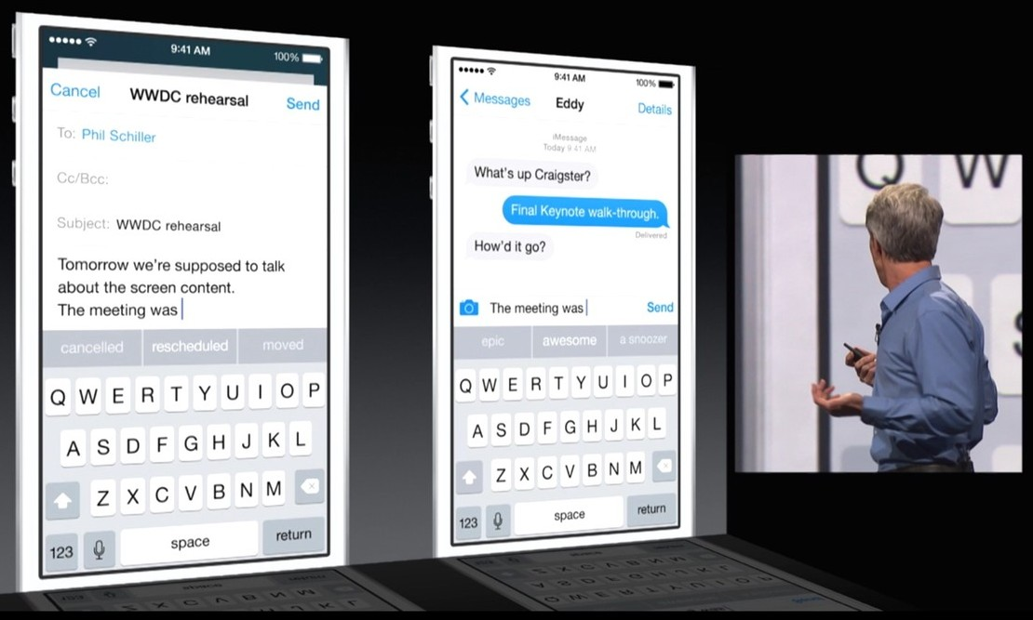
Automatic Completion
10

Slide 11
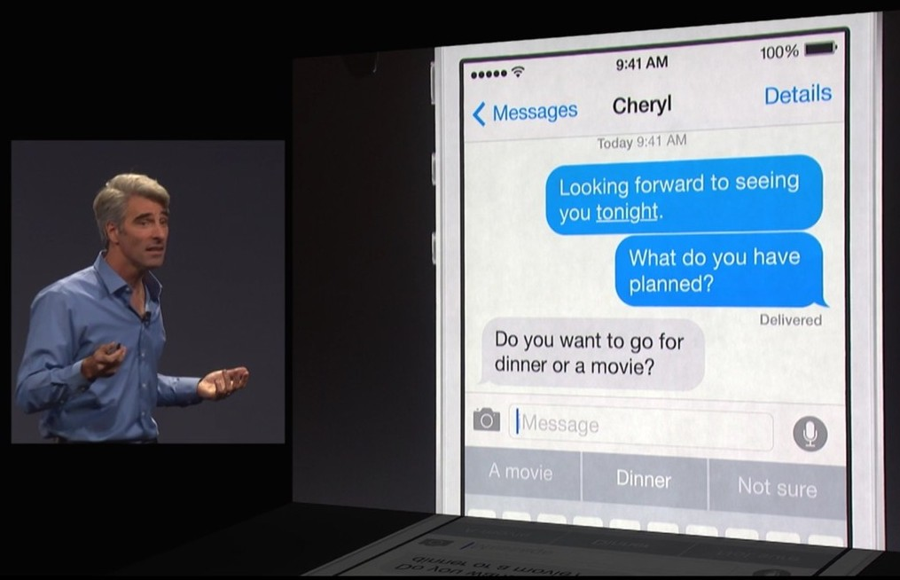
Automatic Completion
11

Slide 12
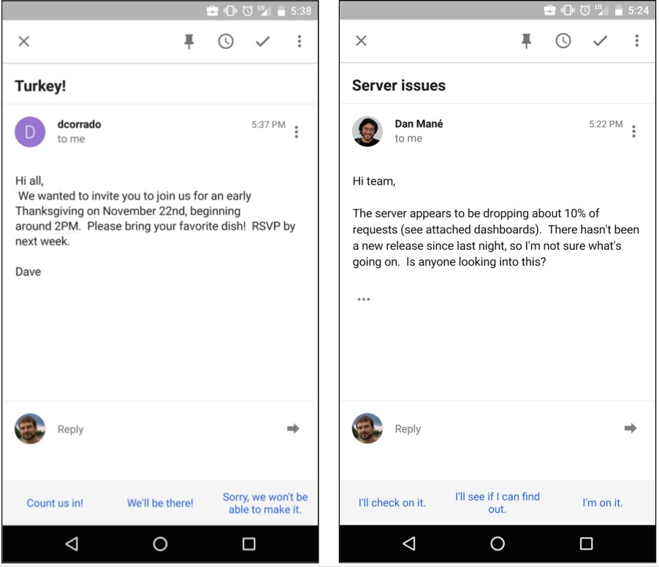
12

Slide 13
Next Word Presentation
From The Glob and MAIL
The Ontario Brain…
The Ontario Brain Institute….
The Ontario Brain Institute, announced by ….
The Ontario Brain Institute, announced by Premier…
he Ontario Brain Institute, announced by Premier Dalton McGuinty ….
The Ontario Brain Institute, announced by Premier Dalton McGuinty on Monday, will provide …
The Ontario Brain Institute, announced by Premier Dalton McGuinty on Monday, will provide $15-million over three years for collaborative research on neuroscience.

Slide 14
Language Model
Language Model (LM)
A language model is a probability distribution over entire sentences or texts
N-gram: unigrams, bigrams, trigrams,…
In a simple n-gram language model, the probability of a word, conditioned on some number of previous words

Slide 15
Probabilistic Language Modeling
Goal: compute the probability of a sentence or sequence of words:
P(W) = P(w₁,w₂,w₃,w₄,w₅…w_{n})
Related task: probability of an upcoming word:
P(w₅|w₁,w₂,w₃,w₄)
A model that computes either of these:
P(W) or P(w_{n}|w₁,w₂…w_{n-1}) is called a language model.
Better: the grammar But language model or LM is standard

Slide 16
How to predict the next word?
Assume a language has T word types in its lexicon, how likely is word x to follow word y?
Solutions:
Estimate likelihood of x occurring in new text, based on its general frequency of occurrence estimated from a corpus
popcorn is more likely to occur than unicorn
Condition the likelihood of x occurring in the context of previous words (bigrams, trigrams,…)
mythical unicorn is more likely than mythical popcorn

Slide 17
How to compute P(W)
How to compute this joint probability:
P(its, water, is, so, transparent, that)
Intuition: let’s rely on the Chain Rule of Probability

Slide 18
The Chain Rule: General
The definition of conditional probabilities
P( A | B ) = P( A, B ) / P( B )
Rewriting: P( A, B ) = P( A | B ) P( B )
More variables:
P(A,B,C,D) = P(A)P(B|A)P(C|A,B)P(D|A,B,C)
The Chain Rule in General
P(x₁,x₂,x₃,…,x_{n}) = P(x₁)P(x₂|x₁)P(x₃|x₁,x₂)…P(x_{n}|x₁,…,x_{n-1})

Slide 19
The Chain Rule: joint probability in sentence
P(“its water is so transparent”) =
P(its) × P(water|its) × P(is|its water) ×
P(so|its water is) × P(transparent|its water is so)

Slide 20
How to estimate these probabilities
Could we just count and divide?
No! Too many possible sentences!
We’ll never see enough data for estimating these
Notes:
We don’t know any way to compute the exact probability of a word given a long sequence of preceding words.

Slide 21
We don’t know any way to compute the exact probability of a word given a long sequence of preceding words,
The intuition of the n-gram model is that instead of computing the probability of a word given its entire history, we can approximate the history by just the last few words.

Slide 22
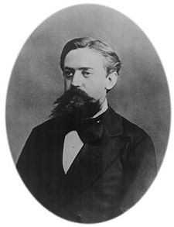
Markov Assumption
Simplifying assumption:
Or maybe
Andrei Markov

Slide 23
Markov Assumption
In other words, we approximate each component in the product

Slide 24
Simplest case: Unigram model
Some automatically generated sentences from a unigram model
fifth, an, of, futures, the, an, incorporated, a, a, the, inflation, most, dollars, quarter, in, is, mass
thrift, did, eighty, said, hard, 'm, july, bullish
that, or, limited, the

Slide 25
QUESTION 1
Which is assigned higher probability by a unigram language model for English?
P(I like ice cream)
P(the the the the)
P(Go to class daily)
P(class daily go to)

Slide 26
Bigram model
Condition on the previous word:
texaco, rose, one, in, this, issue, is, pursuing, growth, in, a, boiler, house, said, mr., gurria, mexico, 's, motion, control, proposal, without, permission, from, five, hundred, fifty, five, yen
outside, new, car, parking, lot, of, the, agreement, reached
this, would, be, a, record, november

Slide 27
N-gram models
We can extend to trigrams, 4-grams, 5-grams
In general this is an insufficient model of language
because language has long-distance dependencies:
“The computer which I had just put into the machine room on the fifth floor crashed.”
But we can often get away with N-gram models

Slide 28
Estimating N-gram Probabilities

Slide 29
Estimating bigram probabilities
The Maximum Likelihood Estimate (MLE)

Slide 30

An example
<s> I am Sam </s>
<s> Sam I am </s>
<s> I do not like green eggs and ham </s>

Slide 31
QUESTION 2
If we estimate a bigram language model from the following corpus, what is P(not|do)?
<s> I am Sam </s>
<s> Sam I am </s>
<s> I do not like green eggs and ham </s>

Slide 32
More examples: Berkeley Restaurant Project sentences
(A sample of 9332 sentences):
can you tell me about any good cantonese restaurants close by
mid priced thai food is what i’m looking for
tell me about chez panisse
can you give me a listing of the kinds of food that are available
i’m looking for a good place to eat breakfast
when is caffe venezia open during the day

Slide 33
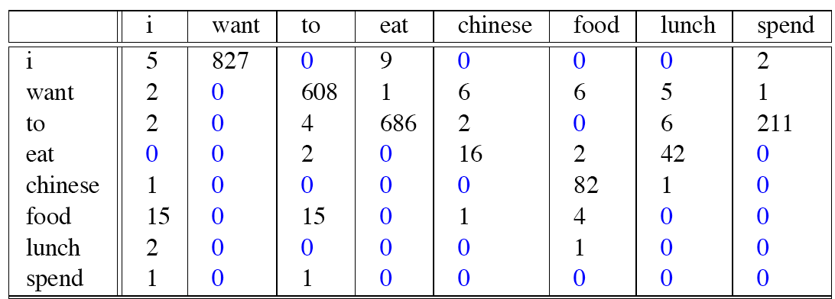
Raw bigram counts (absolute measure)
Note that the majority of the values are zero.
Out of 9222 sentences

Slide 34
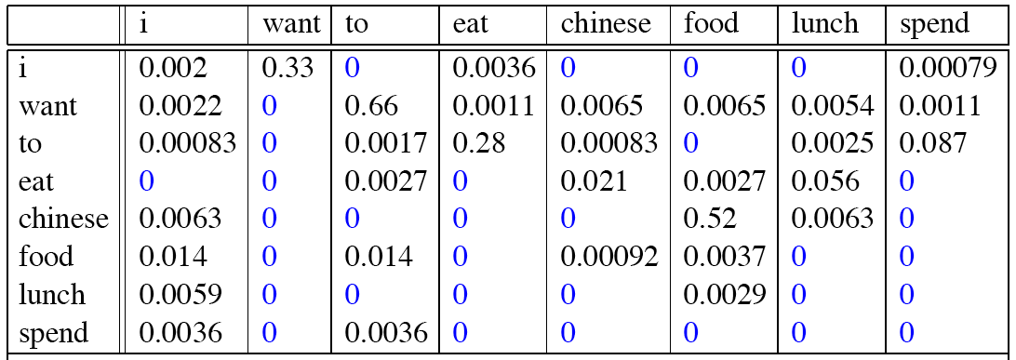
Raw bigram probabilities (relative measure)
Normalize by unigrams:
Result:

Slide 35
Bigram estimates of sentence probabilities
P(<s> I want english food </s>) =
P(I|<s>)
× P(want|I)
× P(english|want)
× P(food|english)
× P(</s>|food)
= .000031

Slide 36
What kinds of knowledge?
P(english|want) = .0011
P(chinese|want) = .0065
P(to|want) = .66
P(eat | to) = .28
P(food | to) = 0
P(want | spend) = 0
P (i | <s>) = .25
world
grammar
grammar (contingent zero)
grammar (structural zero)

Slide 37
Practical Issues
We do everything in log space
Avoid underflow: multiplying extremely small numbers
Adding is faster than multiplying

Slide 38
Evaluation and Perplexity

Slide 39
Evaluation: How good is our model?
Does our language model prefer good sentences to bad ones?
Assign higher probability to “real” or “frequently observed” sentences
Than “ungrammatical” or “rarely observed” sentences?
We train parameters of our model on a training set.
We test the model’s performance on data we haven’t seen.
A test set is an unseen dataset that is different from our training set, totally unused.
An evaluation metric tells us how well our model does on the test set.

Slide 40
Extrinsic evaluation of N-gram models
Best evaluation for comparing models A and B
Put each model in a task
spelling corrector, speech recognizer, machine translation system
Run the task, get an accuracy for A and for B
How many misspelled words corrected properly
How many words translated correctly
Compare accuracy for A and B

Slide 41
Difficulty of extrinsic (in-vivo) evaluation of N-gram models
Extrinsic evaluation
Time-consuming; can take days or weeks
So instead
Sometimes use intrinsic evaluation: perplexity
Bad approximation
unless the test data looks just like the training data
So generally only useful in pilot experiments
But is helpful to think about.

Slide 42
Intuition of Perplexity
mushrooms 0.1
pepperoni 0.1
anchovies 0.01
….
fried rice 0.0001
….
and 1e-100
How well can we predict the next word?
Unigrams are terrible at this game. (Why?)
A better model
is one which assigns a higher probability to the word that actually occurs
I always order pizza with cheese and ____
The 33rd President of the US was ____
I saw a ____

Slide 43
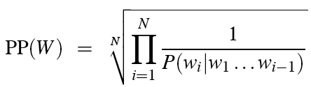
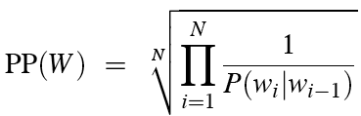
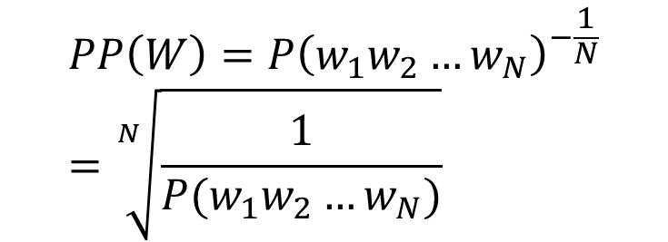
Perplexity
The best language model is one that best predicts an unseen test set
Gives the highest P(sentence)
$$PP\left(W\right)={P\left(w_{1}w_{2}…w_{N}\right)}^{−\frac{1}{N}}=\sqrt[N]{\frac{1}{P(w_{1}w_{2}…w_{N})}}$$
Perplexity is the probability of the test set, normalized by the number of words:
Chain rule:
For bigrams:
Minimizing perplexity is the same as maximizing probability

Slide 44
Example
How hard is the task of recognizing digits ‘0,1,2,3,4,5,6,7,8,9’
Perplexity 10
How hard is recognizing (30,000) names at Microsoft.
Perplexity = 30,000
If a system has to recognize
Operator (25% of the time)
Sales (25% of the time)
Technical Support (25% of the time)
30,000 names (overall 25% of the time, 1 in 120,000 each)
Perplexity is 52.64 ≈ 53 – computed via the geometric mean formula
Perplexity is weighted equivalent branching factor (number of possible children)

Slide 45
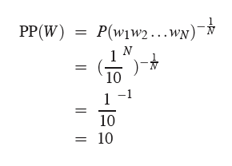
Perplexity as branching factor
Let’s suppose a sentence consisting of random digits
What is the perplexity of this sentence according to a model that assign P=1/10 to each digit?

Slide 46
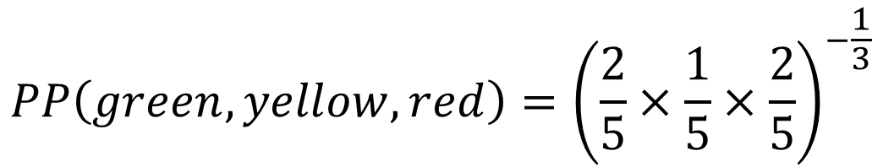
QUESTION 3
A traffic signal has three colors: green, yellow, and red, which appear with the following probabilities. Using a unigram model, what is the perplexity of the sequence (green, yellow, red)?
P(green) = 2/5
P(yellow) = 1/5
P(red) = 2/5
$$PP\left(green, yellow, red\right)={\left(\frac{2}{5}×\frac{1}{5}×\frac{2}{5}\right)}^{−\frac{1}{3}}$$

Slide 47
Lower perplexity = better model
Training 38 million words, test 1.5 million words, WSJ
N-gram Order | Unigram | Bigram | Trigram
Perplexity | 962 | 170 | 109

Slide 48
Generalization and zeros

Slide 49
The Shannon Visualization Method
Choose a random bigram
(<s>, w) according to its probability
Now choose a random bigram (w, x) according to its probability
And so on until we choose </s>
Then string the words together
<s> I
I want
want to
to eat
eat Chinese
Chinese food
food </s>
I want to eat Chinese food

Slide 50
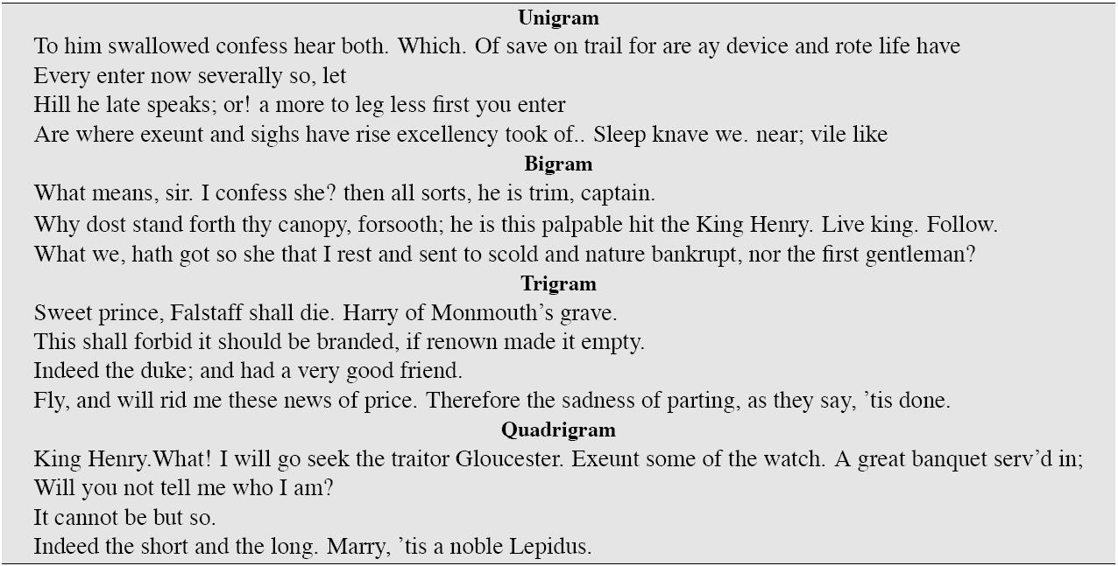
Approximating Shakespeare

Slide 51
Shakespeare as corpus
N=884,647 tokens, V=29,066
Shakespeare produced 300,000 bigram types out of V²= 844 million possible bigrams.
So 99.96% of the possible bigrams were never seen (have zero entries in the table)
Quadrigrams worse: What's coming out looks like Shakespeare because it is Shakespeare

Slide 52
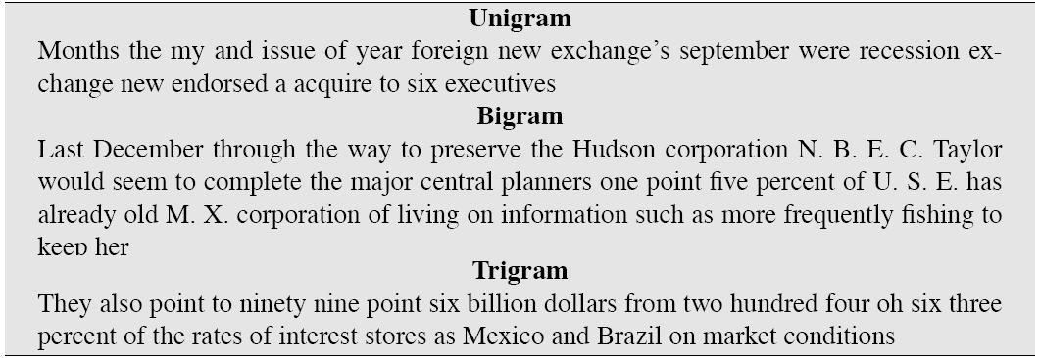
The Wall Street Journal is not Shakespeare

Slide 53
The perils of overfitting
N-grams only work well for word prediction if the test corpus looks like the training corpus
In real life, it often doesn’t
We need to train robust models that generalize!
One kind of generalization: Zeros!
Things that don’t ever occur in the training set
But occur in the test set

Slide 54
Zeros
Training set:
… denied the allegations
… denied the reports
… denied the claims
… denied the request
P(“offer” | denied the) = 0
Test set
… denied the offer
… denied the loan

Slide 55
Zero probability bigrams
Bigrams with zero probability
mean that we will assign 0 probability to the test set!
And hence we cannot compute perplexity (can’t divide by 0)!
Zero mitigation
Various smoothing techniques

Slide 56
Basic Smoothing: Interpolation and Back-off

Slide 57
Backoff and Interpolation
Sometimes it helps to use less context
Condition on less context for contexts you haven’t learned much about
Backoff:
use trigram if you have good evidence,
otherwise bigram, otherwise unigram
Interpolation:
mix unigram, bigram, trigram
Interpolation works better

Slide 58
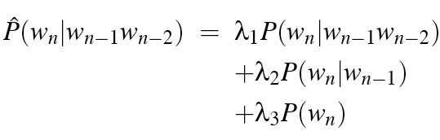

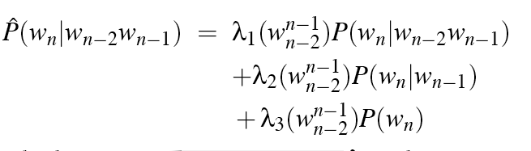
Linear Interpolation
Simple interpolation
Lambdas conditional on context

Slide 59
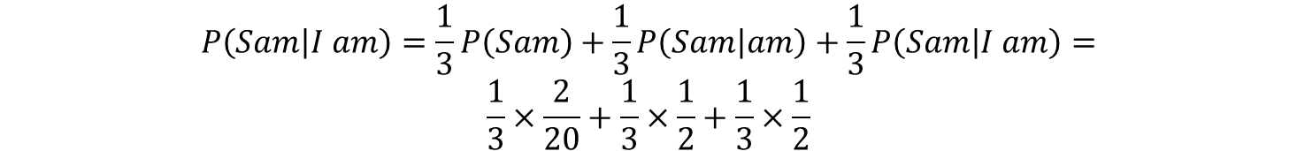
QUESTION 4
Suppose we train unigram, bigram and trigram language models on the following corpus:
<s> I am Sam </s>
<s> Sam I am </s>
<s> I do not like green eggs and ham </s>
What is P(Sam|I am) if we use linear interpolation with λi=1/3?
$$P\left(Sam | I am\right)=\frac{1}{3}P\left(Sam\right)+\frac{1}{3}P\left(Sam | am\right)+\frac{1}{3}P\left(Sam | I am\right)=$$
$$\frac{1}{3}×\frac{2}{20}+\frac{1}{3}×\frac{1}{2}+\frac{1}{3}×\frac{1}{2}$$

Slide 60
How to set the lambdas?
Use a held-out corpus
Choose λs to maximize the probability of held-out data:
Fix the N-gram probabilities (on the training data)
Then search for λs that give largest probability to held-out set:
Training Data
Held-Out Data
Test
Data

Slide 61
Unknown words: open vs closed vocabulary
If we know all the words in advance
Vocabulary V is fixed
Closed vocabulary task
Often we don’t know this
Out Of Vocabulary = OOV words
Open vocabulary task
Instead: create an unknown word token <UNK>
Training of <UNK> probabilities
Create a fixed lexicon L of size V
At text normalization phase, any training word not in L changed to <UNK>
Now we train its probabilities like a normal word
At decoding time
If text input: Use UNK probabilities for any word not in training

